Slide 1

Temperature Control in Industrial Processes Using Sensors and Programming
Automated monitoring for precise thermal management
Notes:
AI-generated content may be incorrect. ---

Slide 2
Precision Temperature Control Solutions
Notes:
Overview of Temperature Control Challenges, Role of Sensors in Improving Accuracy, Programming for Adaptive Temperature Control, Enhanced Precision Through Integrated Systems, Benefits and Outcomes of Adaptive Control Mechanisms

Slide 3
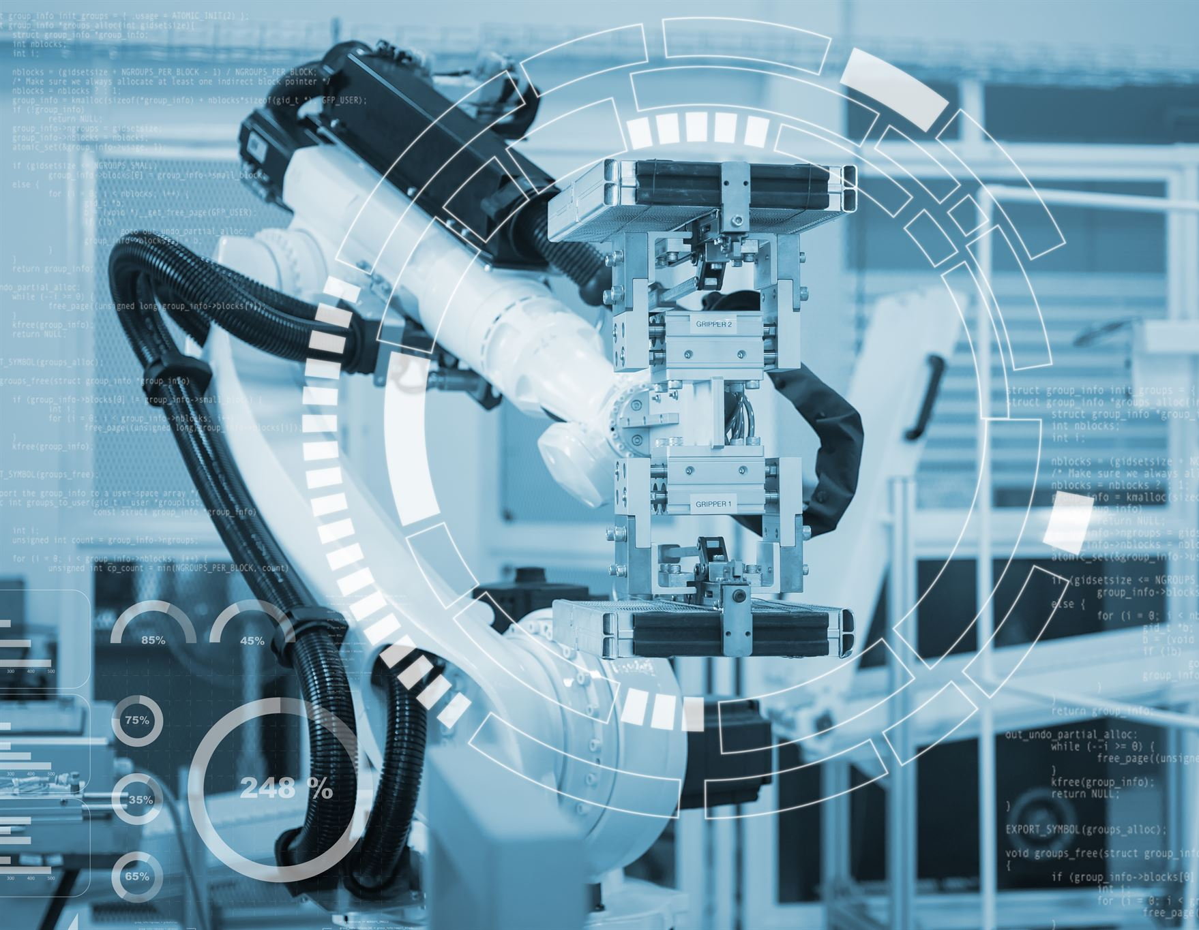
Overview of Temperature Control Challenges
Limitations of Traditional Control
Conventional temperature systems lack adaptive feedback, causing poor precision and unstable thermal conditions.
Impact of Environmental Variations
Fluctuations in raw materials and ambient conditions disrupt heat transfer and process stability.
Challenges of Manual Calibration
Manual adjustments introduce human error and reduce responsiveness in modern automated environments.
Advances with Automated Control
Smart sensors and control loops enable real-time adjustments, improving accuracy and energy efficiency.
Notes:
Temperature control in industrial processes is a critical factor influencing product quality, safety, and operational efficiency. However, many traditional temperature regulation systems suffer from poor precision due to the absence of adaptive feedback mechanisms. This often results in unstable thermal conditions because conventional controllers are typically designed with fixed parameters that cannot react dynamically to changes in the process environment. For instance, fluctuations in raw material properties, ambient temperature variations, or system load can significantly alter heat transfer characteristics. Without real-time feedback, the system cannot compensate quickly, leading to inefficiencies and deviations from optimal conditions. Another major issue is manual calibration, which introduces human error and lacks the responsiveness required for modern automated environments. The problem becomes even more pronounced in industries such as chemical manufacturing, food processing, pharmaceuticals, and semiconductor fabrication, where temperature variations of even a few degrees can result in defective batches, safety hazards, or regulatory non-compliance. As industrial processes become more complex and demand higher precision, the need for intelligent, automated, and adaptive temperature control systems has become essential. Sensors and programming technologies address these challenges by creating control loops that continuously monitor, analyze, and adjust thermal conditions in real time. These modern approaches not only enhance accuracy but also support predictive maintenance, reduce energy consumption, and improve overall process stability. By integrating advanced sensor networks and programmable control algorithms, industries can move toward smarter manufacturing systems that operate with higher precision and reliability.

Slide 4
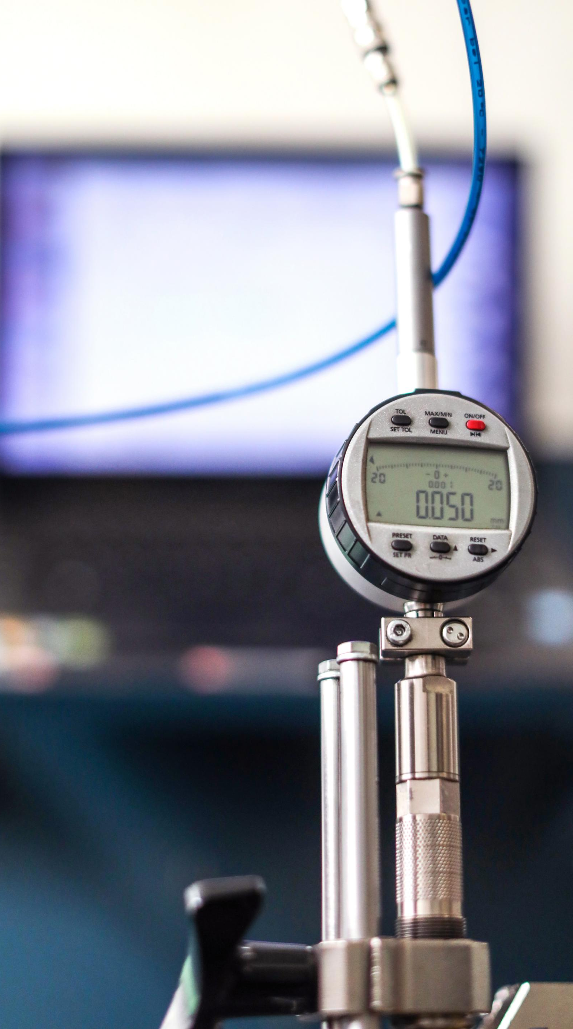
Role of Sensors in Improving Accuracy
Accurate Temperature Monitoring
Modern sensors provide continuous, high-resolution temperature data even in harsh industrial environments.
Real-Time Response
Fast sensor response times allow immediate detection and correction of temperature deviations.
Integration and Data Transmission
Advanced sensors support digital communication protocols for seamless integration and data sharing.
Spatial Temperature Mapping
Sensor networks enable mapping of temperature across equipment to detect hotspots and uneven heating.
Notes:
Sensors play an essential role in achieving precise temperature control by providing continuous, accurate, and high-resolution data about the thermal conditions within an industrial process. Modern temperature sensors—such as thermocouples, resistance temperature detectors (RTDs), infrared sensors, and thermistors—offer reliable readings even in harsh environments characterized by extreme heat, pressure, or chemical exposure. These sensors enable real-time monitoring, ensuring that any deviation from the desired temperature range is detected immediately. With their fast response times, they allow control systems to react to changes almost instantaneously, minimizing fluctuations and maintaining stability. Additionally, advanced sensors support digital communication protocols, making it easier to integrate them into automated systems and enabling seamless data transmission to controllers or cloud platforms. This integration allows for sophisticated data analysis, anomaly detection, and predictive modeling. Sensor networks can also provide spatial temperature mapping across large equipment, identifying hotspots or uneven heating patterns that would be impossible to detect manually. By supplying accurate and timely data, sensors form the foundation of adaptive feedback mechanisms that improve process consistency, reduce waste, and enhance product quality.

Slide 5
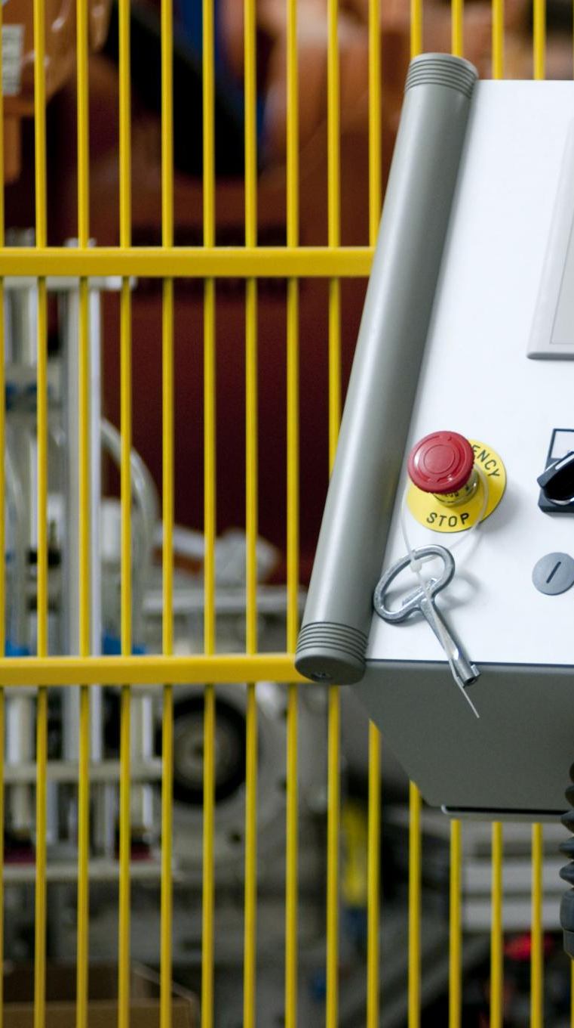
Programming for Adaptive Temperature Control
Role of Programming
Programming enables adaptive feedback by processing sensor data and controlling heating or cooling devices in real-time.
Control Algorithms
Algorithms like PID, fuzzy logic, and AI-based systems optimize temperature regulation and system stability dynamically.
System Integration and Monitoring
Programming allows integration with supervisory systems, data logging, remote monitoring, and safety protocols.
Predictive Maintenance
Predictive algorithms anticipate temperature deviations, improving responsiveness and reducing errors and energy consumption.
Notes:
Programming is central to implementing adaptive feedback mechanisms in temperature control systems. Through programmable logic controllers (PLCs), microcontrollers, and industrial automation software, engineers can develop algorithms that process sensor input and make real-time adjustments to heating or cooling devices. These control algorithms often include proportional–integral–derivative (PID) logic, fuzzy logic, or artificial intelligence–based decision systems. A programmed controller continuously analyzes temperature data, compares it with target setpoints, and calculates the optimal corrective action to maintain stability. In adaptive systems, the program can modify control parameters dynamically based on process conditions, ensuring that the system responds effectively even when operating environments change. Furthermore, programming enables integration with supervisory control systems, data logging, remote monitoring, and automated safety protocols. Developers can implement predictive algorithms that anticipate temperature deviations before they occur, improving overall responsiveness. With programming, temperature control systems become more intelligent, consistent, and energy-efficient, resulting in a substantial reduction in errors and improved throughput in industrial environments.

Slide 6
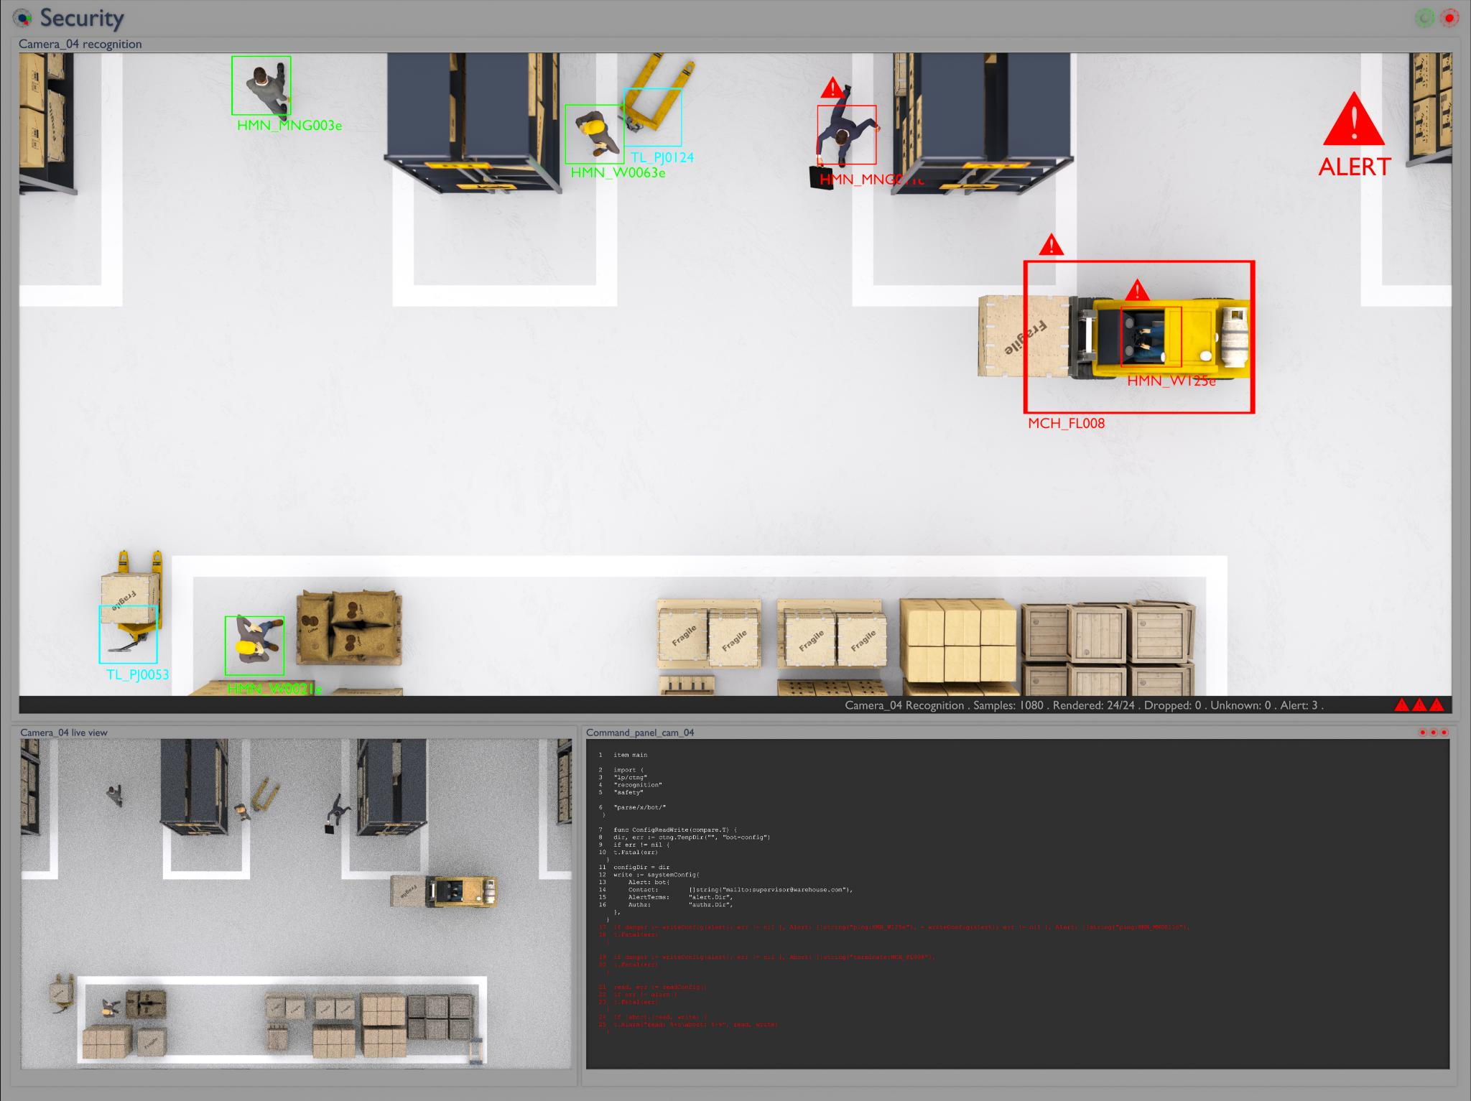
Enhanced Precision Through Integrated Systems
Closed-Loop Control
Sensors provide real-time data to controllers enabling precise temperature regulation through closed-loop control.
Automation and Error Reduction
Integrated systems automate temperature management, minimizing manual intervention and reducing human error risks.
Advanced Safety Features
Systems include alarm triggers, safety shutdowns, predictive maintenance, and analytics to improve safety and efficiency.
Foundation for Smart Factories
Integrated sensor-programmed systems are essential for digital manufacturing and modern smart factory frameworks.
Notes:
When sensors and programming work together in an integrated system, they significantly improve temperature control precision. Real-time data collected by sensors feeds directly into programmed controllers that analyze the information and execute appropriate actions. This closed-loop control structure allows the system to maintain highly stable temperature conditions regardless of external disturbances or internal process variations. The integration also enables automation, reducing reliance on manual intervention and lowering the risk of human error. With continuous monitoring and instant response capabilities, the system can keep temperature deviations within extremely narrow tolerances, which is crucial for processes that demand high consistency and quality. Additionally, integrated systems support advanced features such as alarm triggers, safety shutdowns, predictive maintenance alerts, and detailed performance analytics. These functions not only enhance precision but also improve safety, reduce downtime, and minimize energy consumption. As industries increasingly adopt digital manufacturing frameworks, integrated sensor-programmed control systems are becoming a foundational element of modern smart factories.

Slide 7
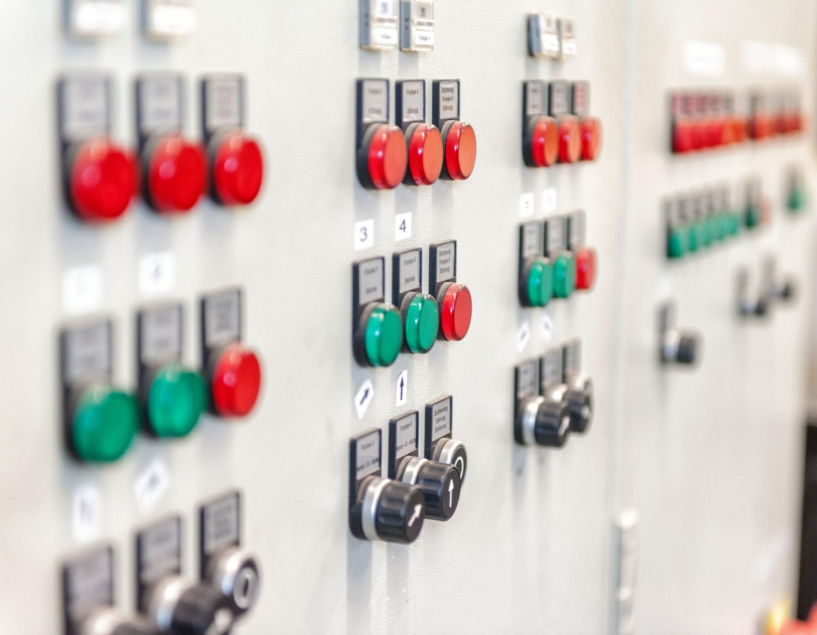
Benefits and Outcomes of Adaptive Control Mechanisms
Improved Precision
Adaptive feedback mechanisms maintain temperature within tight ranges, ensuring product quality.
Enhanced Industrial Safety
Systems detect abnormal temperature rises and trigger emergency shutdowns to prevent accidents.
Energy Efficiency
Control systems optimize power usage by adjusting to real-time temperature needs, reducing waste.
Maintenance and Productivity
Early detection of equipment failure reduces maintenance costs and improves operational uptime.
Notes:
The implementation of sensors and programming in temperature control systems leads to numerous benefits across industrial operations. Improved precision is one of the most significant advantages, as adaptive feedback mechanisms ensure that temperature remains within the desired range with minimal deviation. This precision contributes to higher product quality, especially in processes that rely heavily on consistent thermal conditions. Industrial safety also improves because systems can automatically detect abnormal temperature rises and trigger corrective actions or emergency shutdowns. Energy efficiency is another major benefit, as smarter control systems adjust power usage according to real-time needs rather than operating continuously at high capacity. Automated systems also reduce maintenance costs because they can identify early signs of equipment failure, enabling timely repairs. Additionally, these systems enhance productivity by minimizing downtime and ensuring smooth operation. In industries under strict regulatory control, such as pharmaceuticals and food production, precise temperature control helps maintain compliance with quality standards. Overall, adaptive temperature control systems enhance reliability, reduce waste, and support sustainable industrial practices.

